Slide 1
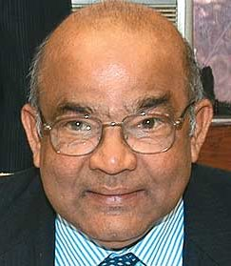
14th Finance Commission
Indian Polity M.Laxmikanth Ch.41
Survey vol1, chapter10
14th FC report Vol1

Slide 2
Membership
FC-280
Dr. Y.V. Reddy | Chairman, Ex-RBI gov.
1. Prof. Abhijit Sen (Part Time) | Ex-Planning Commission member
2. Ms. Sushama Nath | Ex-Finance Secretary
3. Dr. M. Govinda Rao | Director, National Institute for Public Finance and Policy, New Delhi
4. Dr. Sudipto Mundle | Ex-Acting chief of National Statistical Commission
Secretary | Ajay Narayan Jha, IAS
Formed | 2013, Jan
Report | 2014, Dec.
Implementation | 1st April 2015 to 31st March 2021

Slide 3
14th FC: report
Function
1.Tax devolution
4.Others
3.Grant-in-Aid
2.PRI-SFC

Slide 4
14th FC=> other matters referred by President
4.Others
Public utility Pricing
Fiscal deficit review
Disinvestment
Disaster Management
GST
Polavaram
Climate /Sus.Development

Slide 5

14th FC Report
1.Tax devolution
4.Others
3.Grant-in-Aid
Vertical (42%)
Horizontal
2.PRI-SFC

Slide 6
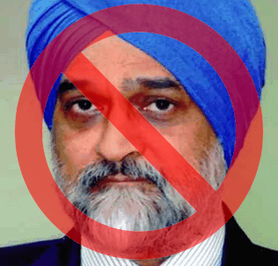
Total transfer to States
FC
Tax Devolution
#280
PC/FinMin
State Plan grants
Grant-in-Aid #275
Implementing Agencies (2014)
CSS funds

Slide 7
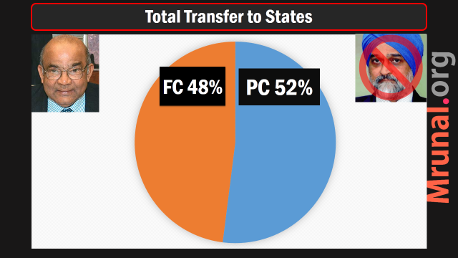
This should be majority

Slide 8
Formula based, “unconditional” transfer
States hv 2 contribute
90:10, 75:25 etc.
“One-size fits all”

Slide 9
FC: Transfer to States
FC
Tax Devolution #280
Grant-in-Aid #275
Verticle (42%)
Horizontal

Slide 10

268- levied by union but collected & kept by States
Stamp duty- cheque, prom-notes, insurance policy, share transfer
Excise duty on medical and toiletry prep. With alcohol / narcotics.
Don’t go to consolidated fund of India

Slide 11

269: levied, collected by union but assigned to states
Inter state commerce
Central sales tax (CST)
Belongs to “exporter” state.
Income Shown as “--” in the Annual financial statement (budget)

Slide 12
FC: share yes
FC Share: No
Corporation Tax
Income Tax
Excise duty
Service Tax
Customs duty
STT
Wealth Tax
Art. 268 (Stamp + Deo)
Art. 268-A: service tax-yes but not with J&K
Art. 269 (CST / Ebay)
Art. 270 (Cess)
Art. 271 (Surcharges)

Slide 13
FC: Transfer to States
FC
Tax Devolution #280
Grant-in-Aid #275
Verticle (42%)
Horizontal

Slide 14
Tax devolution (All central taxes*)
“divisible Pool”
12th Ranga: 30.5%
13th Kelkar: 32%
14th Reddy: 42%
Union
State
State
Cess, 270
Surcharge, 271
268, 269
Service-J&K
Notes:
Three solutions
Amend Constitution to provide for compulsory sharing of cess and surcharges (difficult)
Eliminate cess and surcharges from budget itself. (Jaitley did for most)
Increase the share of states from other divisible taxes (14FC did by increasing from 32% to 42%)

Slide 15
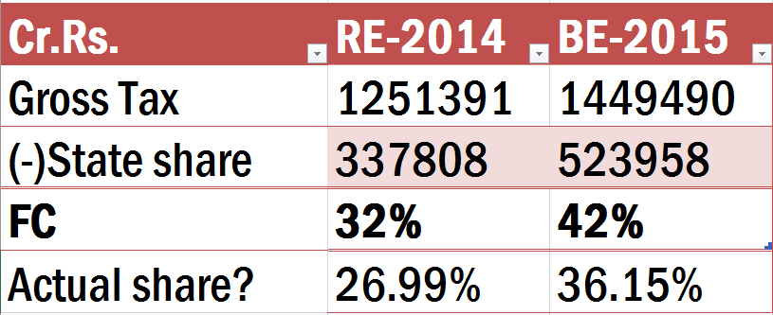
Since Cess and Surcharge not included

Slide 16
Tax devolution (All central taxes*)
“divisible Pool”
12th Ranga: 30.5%
13th Kelkar: 32%
14th Reddy: 42%
Union
State
State
Cess, 270
Surcharge, 271
268, 269
Service-J&K
Horizontal?
Notes:
Three solutions
Amend Constitution to provide for compulsory sharing of cess and surcharges (difficult)
Eliminate cess and surcharges from budget itself. (Jaitley did for most)
Increase the share of states from other divisible taxes (14FC did by increasing from 32% to 42%)

Slide 17
Horizontal distribution
Population Census 1971
Demo.Change Census 2011
Both must be considered, else:
Family planning
Out-migration

Slide 18
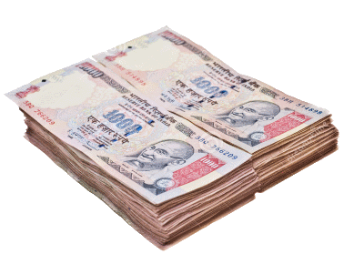
Fiscal capacity income distance
Horizontal
Per capita GSDP compared to best states
Such as Goa, Sikkim,Haryana
Further distance=more money allotted
“progressive” horizontal devolution
To check against income and regional imbalance
Although less progressive than previous FC (no addl. Special category)

Slide 19
Horizontal distribution: 5 variables
Population Census 1971
Demo.Change Census 2011
Income-Distance
Area
Forest-Cover
Opportunity cost

Slide 21
Horizontal distribution: 13th vs 14th
Weights accorded | 13th | 14th
Population (1971) | 25 | 17.5
Population (2011) | 0 | 10

Slide 22
Horizontal distribution: 13th vs 14th
Weights accorded | 13th | 14th
Population (1971) | 25 | 17.5
Population (2011) | 0 | 10
Fiscal capacity Income distance | 47.5 | 50
Area | 10 | 15

Slide 23
Horizontal distribution: 13th vs 14th
Weights accorded | 13th | 14th
Population (1971) | 25 | 17.5
Population (2011) | 0 | 10
Fiscal capacity Income distance | 47.5 | 50
Area | 10 | 15
Forest Cover | 0 | 7.5
Fiscal discipline | 17.5 | 0

Slide 24
Find correct answer?
In horizontal tax devolution formula, the 14th FC, has included ___ as new variables?
Census 1971
Census-2011
Forest cover
Fiscal discipline
Only 1, 2 and 3
Only 2 and 3
Only 1 and 3
All of them
Only 2 and 3
“new”

Slide 25
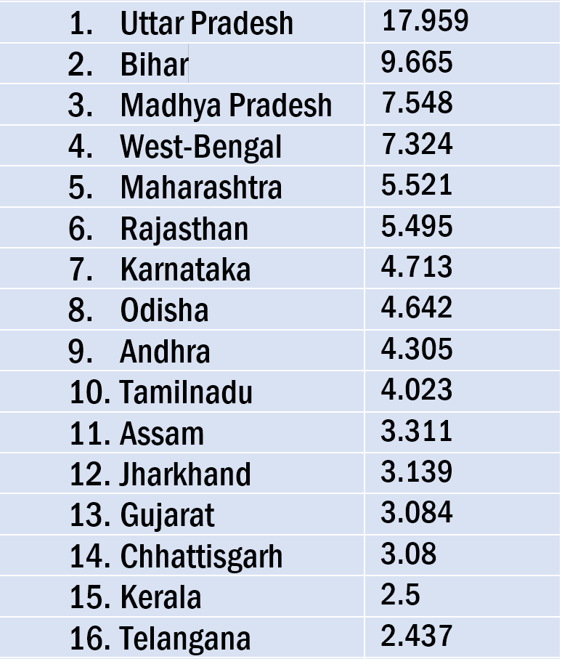
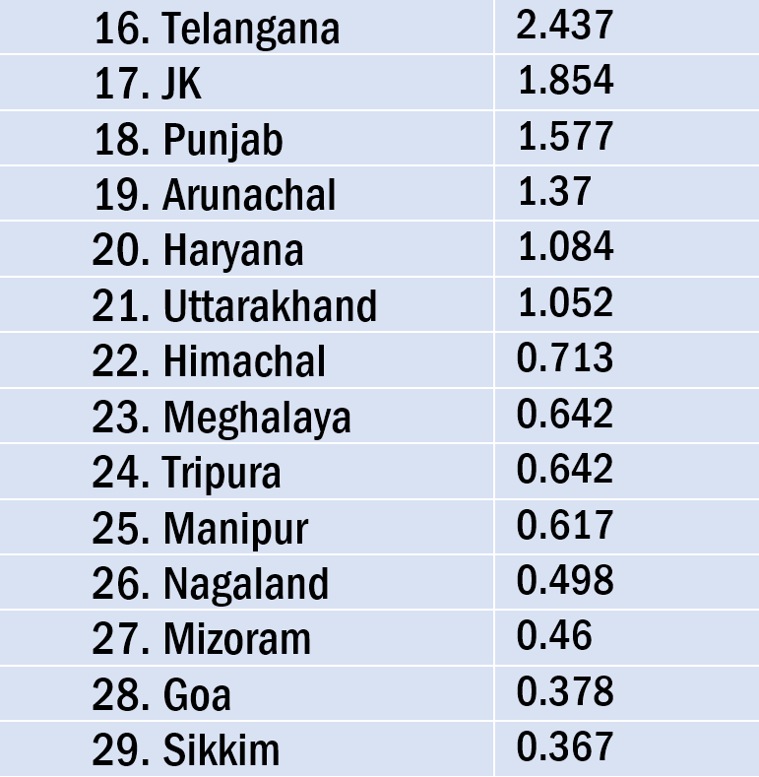
Horizontal distribution
1. Another table for service tax.
Because J&K outside service tax regime.
2. Vol1, ch10- how much gain/loss to your state? (interview)

Slide 26
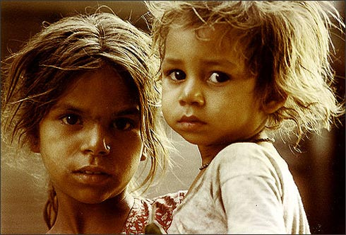
Special vs general category
14th FC
Started with 5th FC
Given additional central grants and tax breaks.

Slide 27
Special category
States
reasons | Special cat. States
hilly and difficult terrain Population density low tribal population high strategic border location Eco. and infrastructure backwardness state finances unviable | Assam* Nagaland* J&K* Arunanchal Pradesh Himachal Pradesh Manipur Meghalaya Mizoram Sikkim Tripura Uttarakhand
(*) from 5th FC
14th FC no addl. Sops
Top gainers- losers

Slide 28

Prof. Abhijit Sen
Criticism
Not 42%, give only 38%
Else less money left for union’s own plans and schemes.
Union will be forced to cut down
MNREGA, NFSA, RTE: can’t cut.
So, BRGF scraped. Bihar, Odisha etc. to suffer.
PRI ministry budget down from 7k to 94

Slide 29
Prof. Abhijit Sen
Criticism
RKVY (Krishi Vikas) budget halved.
So, In absolute figures, Bihar & Odisha et al will get less before.
Will their state Governments increase funds for backward region and agri. From own budget?

Slide 30
Total transfers from union to state
FC: 32->42%
▲1.41 lakh crore
Plan
▼by 1.34 lakh

Slide 31
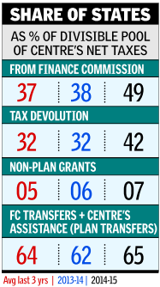
Total transfer: plan + non plan
2014: 7.4 lakh crores
2015: 7.6 lakh crores
=hardly 4% increased.

Slide 32
Prof. Abhijit Sen
recommends
Verticle Tax devolution just 38% and not 42%
Continue Plan transfer as per Gadgil-Mukhrjee formula
Until Niti Ayog picture is clear.
wrote Dissent note, but Government accepted majority view of FC (42%)

Slide 33
Mains Interview
Question
“Acceptance of 14th FC recommendations is a watershed change in the story of Indian federalism.”
“14th FC has delivered a strong push towards true federalism.” Do you agree? Justify your stand.
Pro: untied funds (42%)
Anti: Sen- what about backward states? + faults in horizontal formula.

Slide 34
14th FC Report
1.Tax devolution
4.Others
3.Grant-in-Aid
Vertical (42%)
Horizontal
2.PRI-SFC
Abhi Criticism

Slide 35

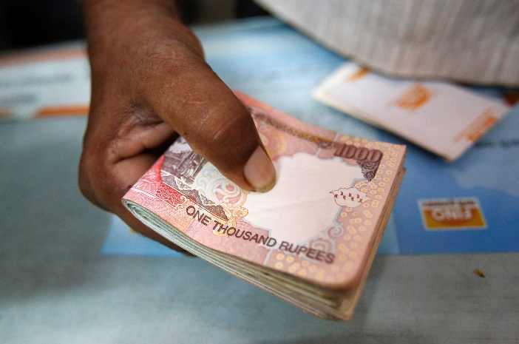
Problem areas
Local bodies
Lack of money
Can’t provide basic amnesties- water, waste Management, street lights etc.
Can’t hire large specialized staff
IT-infrastructure, building repair etc. difficult

Slide 36
Problem areas SFC
Local bodies
73rd Amendment 1992
Form State finance commissions in a year, and thereafter @5 years
But not done at regular interval. Hard to sync. data for FC.
SFC-report not all implemented.
Some implemented but not in Timelimit.

Slide 37
14th FC Report
1.Tax devolution
4.Others
3.Grant-in-Aid
2.PRI-SFC
Grant in Aid
Other reforms

Slide 38
14th FC: helping the local bodies
Grant-in-Aid
Vertical
Rural vs urban
Other measures
Tax-reforms
North East
Horizontal
Muni.bonds

Slide 39
Grant in Aid
10th FC was first to recommend
Union
State
State
Total
2.87 Lakh
90% Population (2011) + 10% Area

Slide 40
Grant in Aid
Union
State
Rural
Urban
State
2.87 Lakh cr.
90% Population (2011) + 10% Area
2 lakh Cr.
87,000 cr

Slide 41
14th FC: Grant in Aid for Local Bodies
Union
State
Rural
Urban
State
90% basic
10% Performance
80% basic
20% Performance
2.87 Lakh cr.
90% Population (2011) + 10% Area
2 lakh Cr.
87,000 cr

Slide 42
14th FC: helping the local bodies
Grant-in-Aid
Vertical
Rural vs urban
Other measures
Tax-reforms
Muni.bonds
Horizontal
North East

Slide 43

State Tax Devolution
PRI funding
States should Share mining royalty
Property tax and advertisement tax
Entertainment tax: cable, net-café, boat rides
Professional Tax: 2500 => 12,000 (Art. 276 amendment needed)
Kerala, TN local bodies get professional tax.

Slide 44
Property Tax
PRI
Increase property tax as per inflation & Development
Assessment every 4-5 years.
Stringent action on evasion

Slide 45
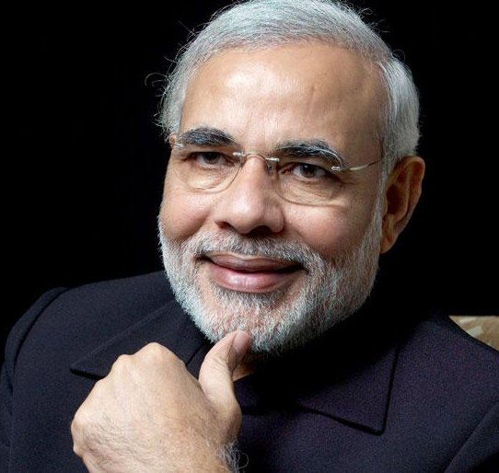
Union properties
PRI funding
Art. 285(1): union properties can’t be taxed by state / local body
Previous FC recommended they should be taxed
14th FC: at least compensate local bodies

Slide 46

North East
Local bodies
Part 9 and 9-A don’t apply to Assam, Meghalaya, Tripura, Manipur (AMTM)
So, FC PRI-reforms not valid for them
Expand 275(1) to fix this lacuna

Slide 47
14th FC: helping the local bodies
Grant-in-Aid
Vertical
Rural vs urban
Other measures
Tax-reforms
Muni.bonds
Horizontal
North East

Slide 48

Muni Bonds
PRI
Large Corp. help them directly launch muni. bonds
Small municipalities: setup intermediary to help them issue bonds.
SEBI norms: L2_P1_Capital Market.pptx

Slide 49
Other measures
Property
Professional
Mining
Northeast
Entertainment
Muni.Bonds
SFC reports

Slide 50
Mains questions
“14th FC has taken extra precautions to ensure local bodies are not left at the mercy of state government.” Elaborate.
“Even after a decade of 73rd & 74th Amendment, PRI bodies have not become a strong and vibrant unit of Government, due to lack of financial resources.” Examine reasons and suggest remedies.

Slide 51
14th FC Report
1.Tax devolution
4.Others
3.Grant-in-Aid
2.PRI-SFC
PRI
Disaster Management
Post devolution revenue deficit

Slide 52
14th FC: Disaster Management
Existing mechanism
Problems and solutions

Slide 53
Funds: National Disaster Management Act 2005
Response
National
Mitigation
National
State
District
State
District
NCCF merged in this
Not all states have formed

Slide 54

Problem areas
NDRF
NCCF (calamity and contingency fund) merged into this (13th FC)
Money from cess on custom-excise, but what after GST?
Design new arrangement to get money in this fund
Give tax exemption to private donors
Encourage CSR funding into this

Slide 55
Present list
NDRF
Cyclones droughts earthquakes fires floods tsunamis Hailstorms | landslides avalanches cloud bursts pest attacks cold waves* Frost*
Limited
* newly added

Slide 56

Calamity list
NDRF
Expand the list of "official calamities" for state-specific disasters:
Heat waves
coastal erosion
bamboo flowering
Snakebites
Monkey and elephant attacks

Slide 57
Funds: National Disaster Management Act 2005
Response
National
State
District
New mechanism for funding
Expand the list

Slide 58

14th FC recommends
SDRF
275(1): Union grants money
So far: 75-25 (General) / 90-10 (Special)
14th FC: 90-10 all
Hazard risk vulnerability index: More vulnerable states get bigger allotment (inflation, labor cost)
Total Rs.61,000 SDRFs

Slide 59
Funds: National Disaster Management Act 2005
Response
National
State
District
New mechanism for funding
Expand the list
90:10 rule
Hazard vul. Index
Make non-compulsory

Slide 60
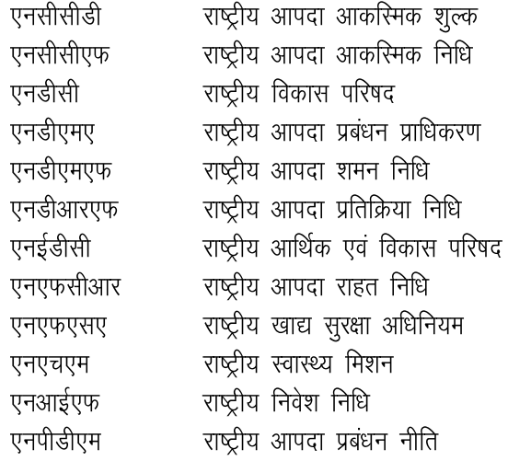
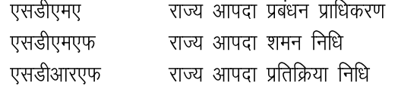
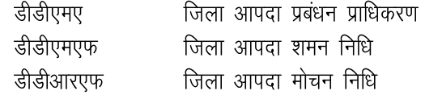
National
State / District

Slide 61
Questions on disasters
MCQ: Who gives money in SDRF? How much
MCQ: How many funds provided in NDMA?
MCQ: List of official calamities.
Mains: Discuss in brief, the constrains in disaster response funding in India, and list the remedies suggested by 14FC.

Slide 62
14th FC Report
1.Tax devolution
4.Others
3.Grant-in-Aid
2.PRI-SFC
PRI
Disaster Management
Post devolution revenue deficit
Sector Specific
Sector specific stopped,
because large $$ announced (42%)

Slide 63
14th FC Report
1.Tax devolution
4.Others
3.Grant-in-Aid
2.PRI-SFC
Coop. Fed
Public Utility
PSE
GST
Fiscal Consolidation

Slide 64

Cooperative federalism
14th FC
Social sector spending:
FC: outside purview
PC/Niti: state Government participation?
Better use Inter-State councils (Art. 263)
Identify sectors, design schemes, distribution-criteria
+focus on NE + environment

Slide 65
14th FC Report
1.Tax devolution
4.Others
3.Grant-in-Aid
2.PRI-SFC
Coop. Fed
Public Utility
PSE
GST
Fiscal Consolidation

Slide 66

Public Utility Pricing
14th FC
Punish states delaying electricity subsidies to companies
State electricity regulatory commissions Fund (SERC)
Rail tariff authority: give statutory status (amend Rai act ‘89)
Independent regulator for road sector

Slide 67

Public Utility Pricing
14th FC
WRA- water regulatory authorities for drinking, irrigation and industrial
Install water meters @customer’s expense
Environment helped…yes

Slide 68
14th FC Report
1.Tax devolution
4.Others
3.Grant-in-Aid
2.PRI-SFC
Coop. Fed
Public Utility
PSE
GST
Fiscal Consolidation
Remaining 3 in Separate lectures on relevant topics

